Slide 1
EEE-301
Data and Telecommunication
Mohammad Shariful Islam
Lecturer
Dept. of CSE
Dhaka International University
Contact no.: 01747612143
Email: Shariful.cse@diu.ac, sharifulruhan@gmail.com

Slide 2
Chapter-3: Signals
Data Communications and Networking, 4th Edition
- Behrouz A. Forouzan

Slide 3
Introduction
One of the major functions of the physical layer is to move data in the form of electromagnetic signals across a transmission medium.
Whether you are collecting numerical statistics from another computer, sending animated pictures at a distant control center, you are working with the transmission of data across network connections.
Generally, the data usable to a person or application are not in a form that can be transmitted over a network.

Slide 4
Introduction
For example, a photograph must first be changed to a form that transmission media can accept.
Transmission media work by conducting energy along a physical path.
Data stream of 1s and 0s must be turned into energy in the form of electromagnetic signals.
Note: To be transmitted, data must be transformed to electromagnetic signals.

Slide 5
Analog and Digital Data
Data can be analog or digital.
The term analog data refers to information that is continuous; digital data refers to information that has discrete states.
Analog data, such as the sounds made by a human voice, take on continuous values.
When someone speaks, an analog wave is created in the air.
This can be captured by a microphone and converted to an analog signal or sampled and converted to a digital signal.

Slide 6
Analog and Digital Data
Digital data take on discrete values.
For example, data are stored in computer memory in the form of 0s and 1s.
They can be converted to a digital signal or modulated into an analog signal for transmission across a medium.
Note: Data can be analog or digital. Analog data are continuous and take continuous values. Digital data have discrete states and take discrete values.

Slide 7
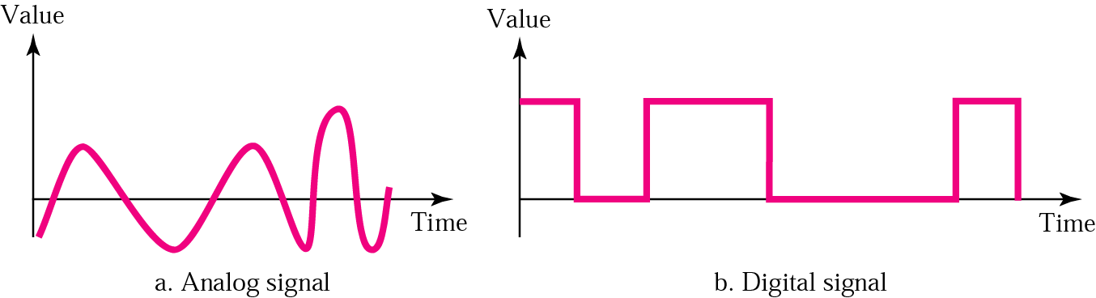
Analog and Digital Signals
Signals can be either analog or digital.
An analog signal has infinitely many levels of intensity over a period of time.
As the wave moves from value A to value B, it passes through and includes an infinite number of values along its path.

Slide 8
Analog and Digital Signals
A digital signal, on the other hand, can have only a limited number of defined values.
Although each value can be any number, it is often as simple as 1 and 0.
Note: Signals can be analog or digital. Analog signals can have an infinite number of values in a range; digital signals can have only a limited number of values.

Slide 9
Periodic and Aperiodic signals
Both analog and digital signals can take one of two forms: periodic or nonperiodic (sometimes refer to as aperiodic, because the prefix a in Greek means "non").
Periodic signal
Completes a pattern within a measurable time frame, called a period.
Repeats that pattern over subsequent identical periods.
The completion of one full pattern is called a cycle.
Aperiodic signal
Change without exhibiting a pattern or cycle that repeat over time.

Slide 10
Note:
In data communications, we commonly use periodic analog signals (because they need less bandwidth) and nonperiodic digital signals (because they can represent variation in data).

Slide 11
PERIODIC ANALOG SIGNALS
Periodic analog signals can be classified as simple or composite.
A simple periodic analog signal, a sine wave, cannot be decomposed into simpler signals.
A composite periodic analog signal is composed of multiple sine waves.

Slide 12
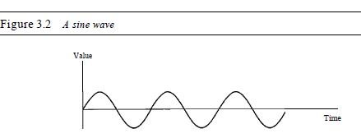
Simple Analog Signals: Sine Waves
The sine wave is the most fundamental form of a periodic analog signal.
When we visualize it as a simple oscillating curve, its change over the course of a cycle is smooth and consistent, a continuous, rolling flow.
Each cycle consists of a single arc above the time axis followed by a single arc below it.

Slide 13
Simple Analog Signals: Sine Waves
A sine wave can be represented by three parameters: the peak amplitude, the frequency, and the phase.
These three parameters fully describe a sine wave.
Peak Amplitude:
The peak amplitude of a signal is the absolute value of its highest intensity, proportional to the energy it carries.
For electric signals, peak amplitude is normally measured in volts.
Figure 3.3 shows two signals and their peak amplitudes.

Slide 14
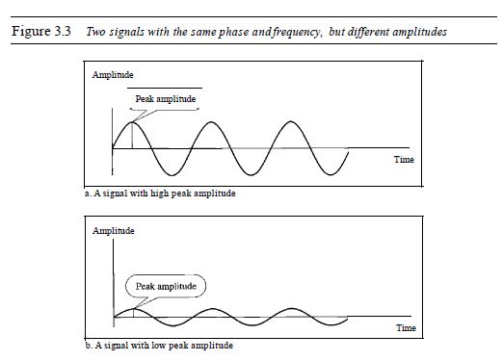
Simple Analog Signals: Sine Waves

Slide 15
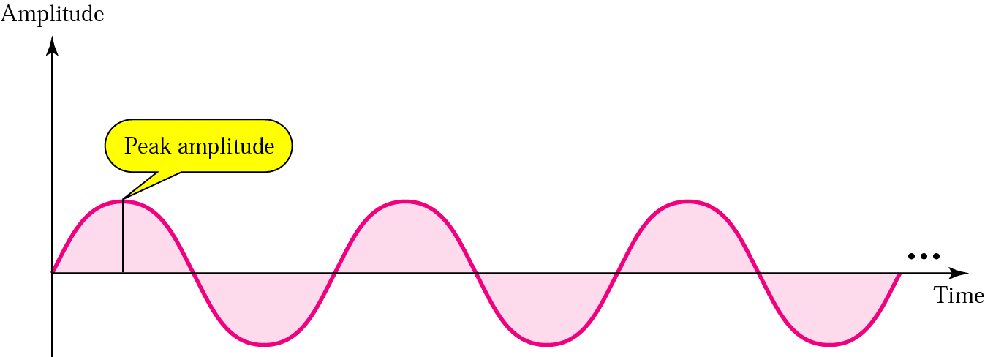
Simple Analog Signals: Sine Waves
s(t) = A.sin(2πft+ф)
A: peak amplitude
f: frequency, t: time, ф: phase

Slide 16
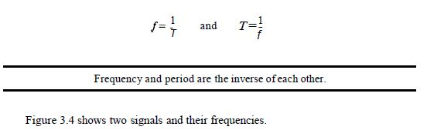
Period and Frequency
Period:
The amount of time (in seconds), a signal needs to complete one cycle.
Frequency:
The number of periods in one second.

Slide 17
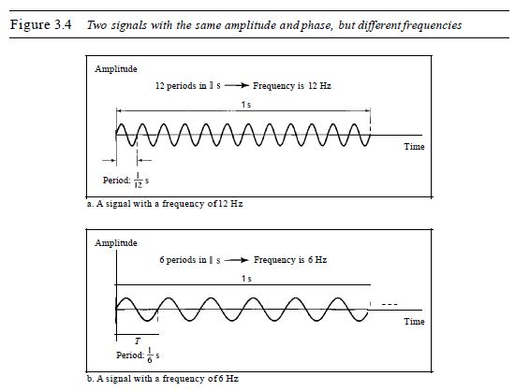
Period and Frequency

Slide 18
Period and Frequency
Period is formally expressed in seconds.
Frequency is formally expressed in Hertz (Hz), which is cycle per second.
Units of period and frequency are shown in Table 3.1.

Slide 19
Units of Frequency and Periods
Period | Equivalent | Frequency | Equivalent
Seconds (s) | 1 s | Hertz (Hz) | 1 Hz
Milliseconds (ms) | 10^{–3} s | Kilohertz (KHz) | 10³ Hz
Microseconds (ms) | 10^{–6} s | Megahertz (MHz) | 10⁶ Hz
Nanoseconds (ns) | 10^{–9} s | gigahertz (GHz) | 10⁹ Hz
Picoseconds (ps) | 10^{–12} s | Terahertz (THz) | 10¹² Hz

Slide 20
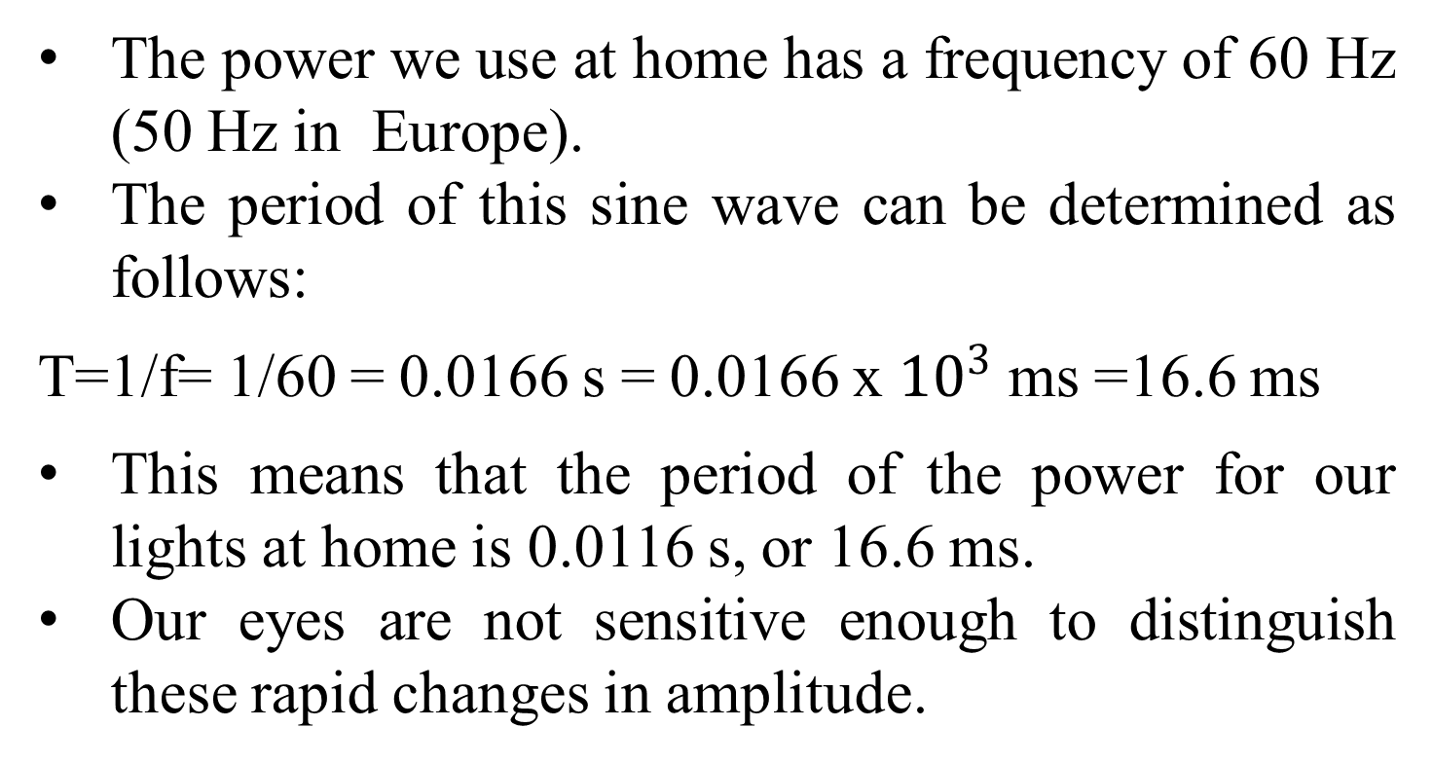
Example 3.3
The power we use at home has a frequency of 60 Hz (50 Hz in Europe).
The period of this sine wave can be determined as follows:
T=1/f= 1/60 = 0.0166 s = 0.0166 x ${10}^{3}$ ms =16.6 ms
This means that the period of the power for our lights at home is 0.0116 s, or 16.6 ms.
Our eyes are not sensitive enough to distinguish these rapid changes in amplitude.

Slide 21
Note:
Frequency is the rate of change with respect to time. Change in a short span of time means high frequency. Change over a long span of time means low frequency.
If a signal does not change at all, its frequency is zero. If a signal changes instantaneously, its frequency is infinite.

Slide 22
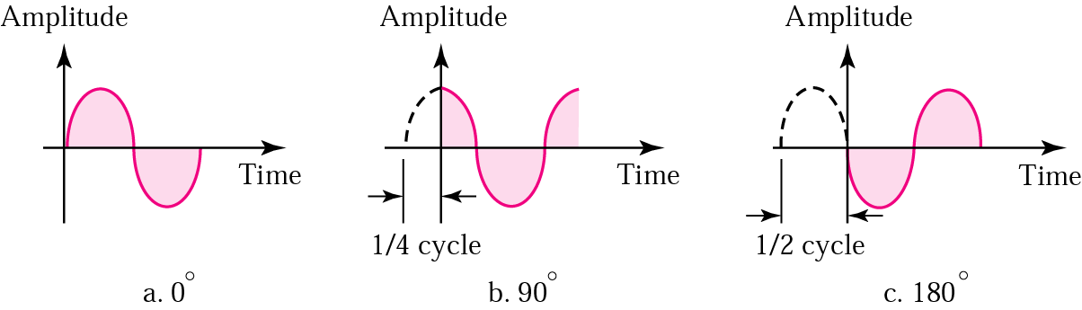
Phase
Phase describes the position of the waveform relative to time zero
Phase is measured in radians or degrees: 360º means 1 cycle shifted
Question: A sine wave is offset one-sixth of a cycle with respect to time zero. What is its phase in degrees and radians???

Slide 23
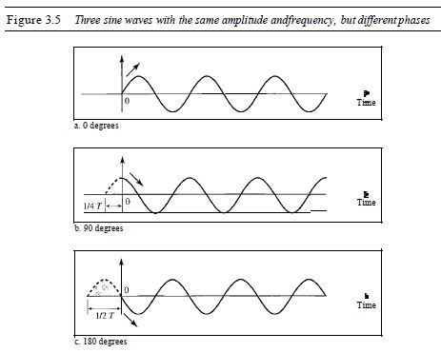

Slide 24
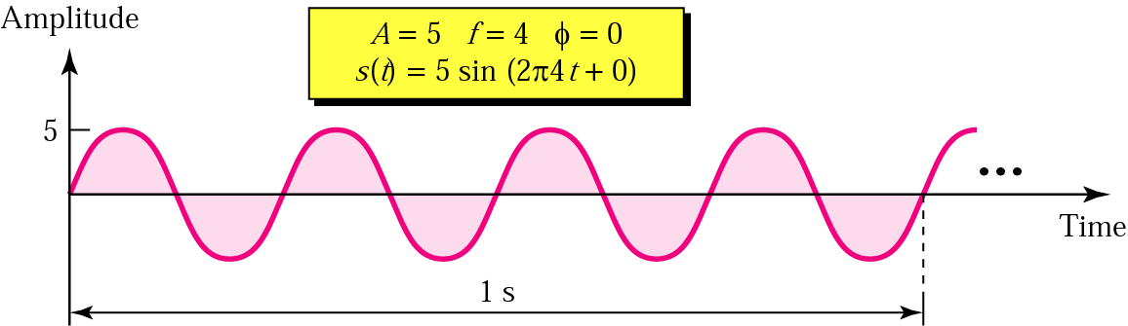
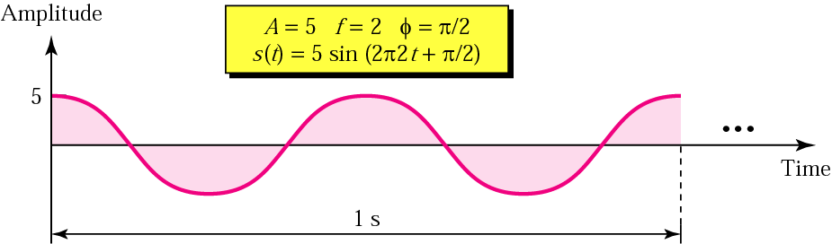
Sine Wave: Examples

Slide 25
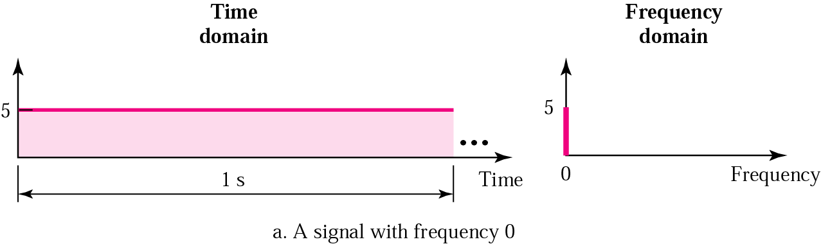
Note:
An analog signal is best represented in the frequency domain.

Slide 26
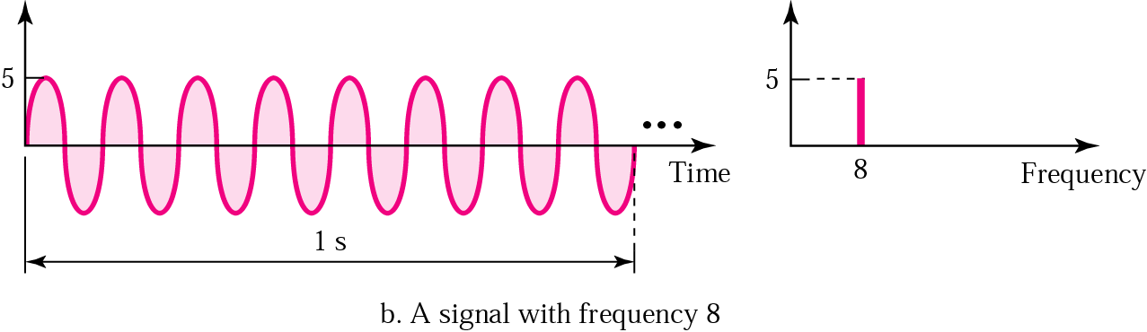
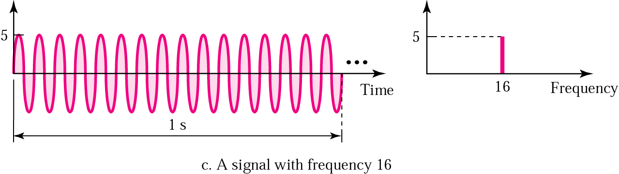
Frequency Domain

Slide 27
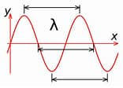
Wavelength
The distance between successive crests of a wave, especially points in a sound wave or electromagnetic wave. It is denoted by the Greek letter lambda (λ).
λ = c/ f
Wavelength= Propagation speed * Period
= Propagation speed / frequency

Slide 28
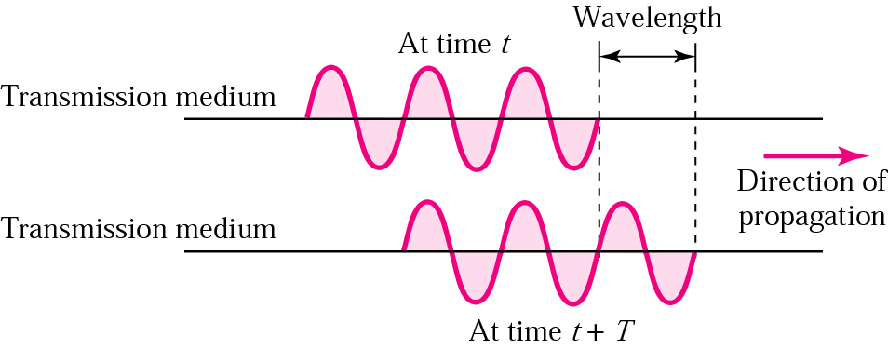
Wavelength
Wavelength (for electromagnetic signals)
= speed-of-light / frequency
= 3*10⁸ (m/s) / frequency

Slide 29
Bandwidth of Transmission Medium
Note:
The bandwidth is a property of a medium: It is the difference between the highest and the lowest frequencies that the medium can satisfactorily pass.
Telephone line: Bandwidth between 3KHz and 4Khz

Slide 30
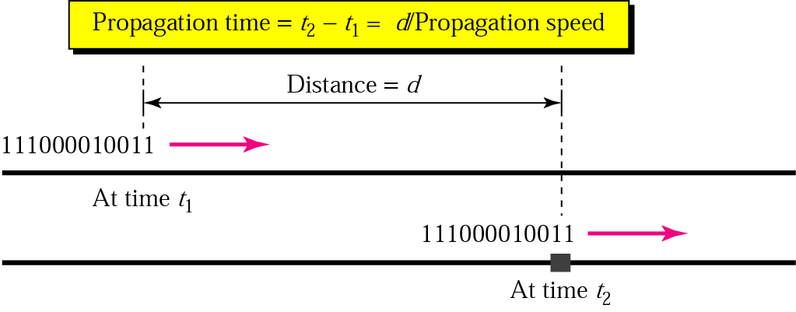
Propagation Time

Slide 31
Digital Signals
In addition to being represented by an analog signal, information can also be represented by a digital signal.
For example, a 1 can be encoded as a positive voltage and a 0 as zero voltage.
A digital signal can have more than two levels.
In this case, we can send more than 1 bit for each level.
Figure 3.16 shows two signals, one with two levels and the other with four.

Slide 32
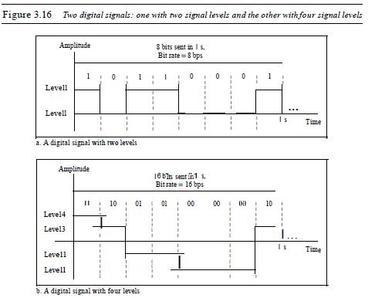

Slide 33
Digital Signals
We send 1 bit per level in part a of the figure and 2 bits per level in part b of the figure.
In general, if a signal has L levels, each level needs log2L bits.
Example 3.16
A digital signal has eight levels. How many bits are needed per level?
We calculate the number of bits from the formula
Number of bits per level =log2 8 =3
Each signal level is represented by 3 bits.

Slide 34
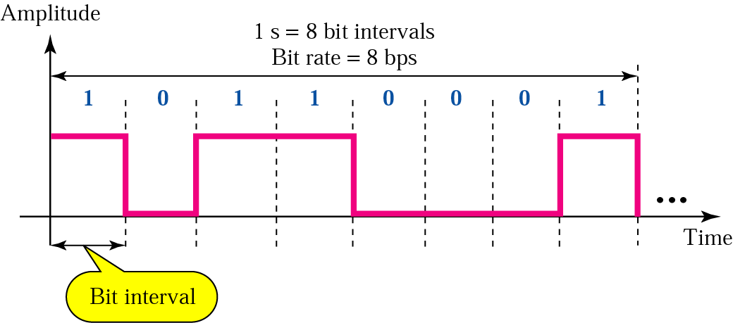
Digital Signals
Most digital signals are aperiodic => frequency or period is irrelevant. Instead, we use the terms “bit rate” and “bit interval”.
The bit rate is the number of bits sent in 1s, expressed in bits per second (bps).

Slide 35
Digital Signals
Example 3.18
Assume we need to download text documents at the rate of 100 pages per minute. What is the required bit rate of the channel?
Solution
A page is an average of 24 lines with 80 characters in each line. If we assume that one character requires 8 bits, the bit rate
=100 x 24 x 80 x 8 =1,636,000 bps =1.636 Mbps

Slide 36
Digital Signals
Example 3.20
What is the bit rate for high-definition TV (HDTV)?
Solution
HDTV uses digital signals to broadcast high quality video signals. The HDTV Screen is normally a ratio of 16 : 9 (in contrast to 4 : 3 for regular TV), which means the screen is wider.
There are 1920 by 1080 pixels per screen, and the screen is renewed 30 times per second. Twenty-four bits represents one colour pixel. We can calculate the bit rate
=1920 x 1080 x 30 x 24 = 1,492,992,000 or 1.5 Gbps
The TV stations reduce this rate to 20 to 40 Mbps through compression.

Slide 37
Digital Bandwidth
Note:
The maximum bit rate that can be passed by the transmission medium
The analog bandwidth of a medium is expressed in hertz; the digital bandwidth, in bits per second.

Slide 38
Digital vs. Analog
Digital’s advantage:
Digital design less expensive and more reliable
Greater dynamic range and error detection and recovery by the use of coding
Many sources can be combine (voice, video, data) and sent over the same channel
Digital’s disadvantage
More bandwidth needed

Slide 39
Data Rate Limits
How fast can we send data (in bps) over a link?
The answer depends on
Bandwidth available
Levels of signals we can use
Quality of channel (level of noise)

Slide 40
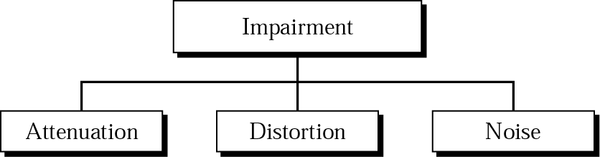
Transmission Impairment
Transmission medium is not perfect => impairment in signal

Slide 41
Attenuation
Attenuation means loss of energy.
When a signal (simple or composite) ,travels through a medium, it losses some energy, so that it can overcome the resistance of the medium.
That is why a wire carrying electric signals gets warms.
And some of the electric energy signal is converted to heat.
To compensate for this lose, the amplifier is used to amplify the signal.

Slide 42
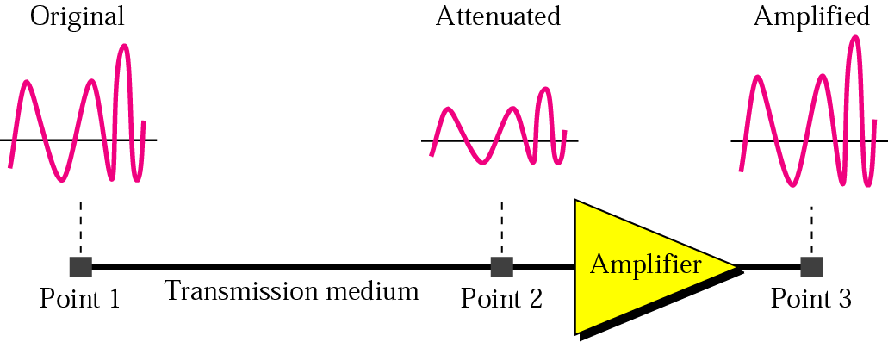
Attenuation
To show that a signal has lost or gained strength, engineers use the unit of the decibel.
The decibel (dB) measures the relative strengths of two signals or a signal at two different points
dB = 10 log₁₀(P₂/P₁)
Variables PI and P2 are the powers of a signal at points 1 and 2, respectively.

Slide 43
Distortion
Distortion:
It means change in the shape of signal.
This is generally seen in composite signals with different frequencies.
Each frequency component has its own propagation speed travelling through a medium.
Every component arrive at different time which leads to delay distortion.
Therefore, they have different phases at receiver end from what they had at senders end.

Slide 44
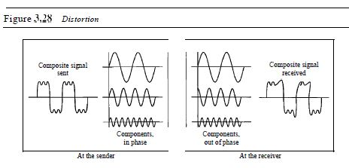
Distortion

Slide 45
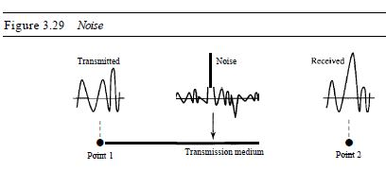
Noise

Slide 46
Noise
Noise – The random or unwanted signal that mixes up with the original signal is called noise.
There are several types of noise such as induced noise, crosstalk noise, thermal noise and impulse noise which may corrupt the signal.

Slide 47
Noise
Thermal noise is the random motion of electrons in a wire which creates an extra signal not originally sent by the transmitter.
Induced noise comes from sources such as motors and appliances. These devices act as a sending antenna, and the transmission medium acts as the receiving antenna.
Crosstalk is the effect of one wire on the other. One wire acts as a sending antenna and the other as the receiving antenna.
Impulse noise is a spike (a signal with high energy in a very short time) that comes from power lines, lightning, and so on.

Slide 48
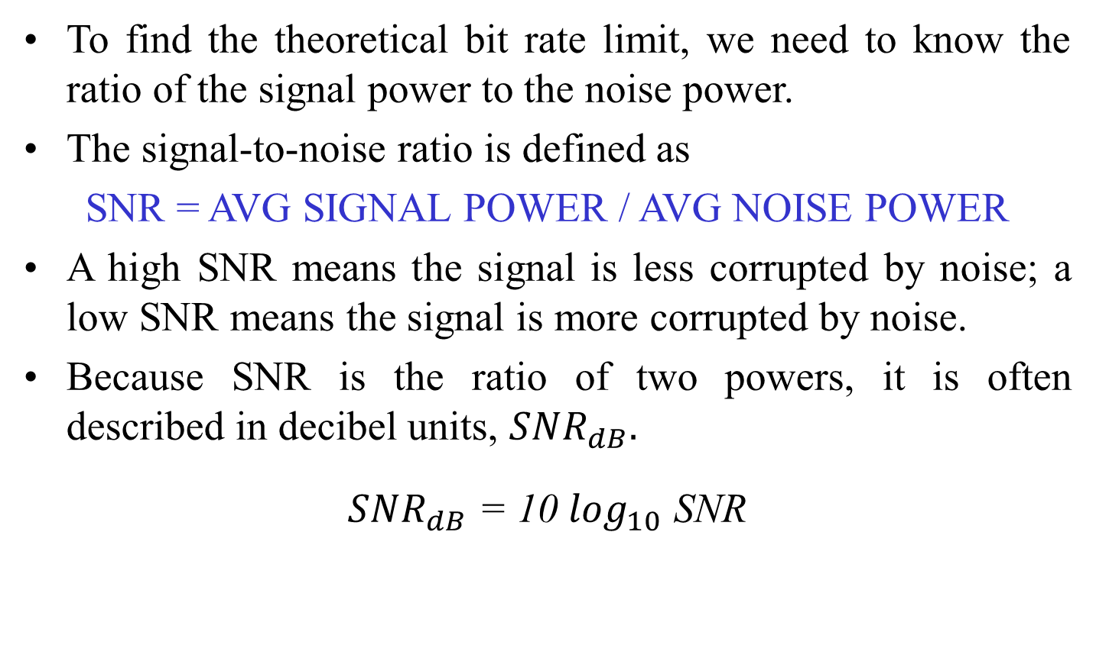
Noise
To find the theoretical bit rate limit, we need to know the ratio of the signal power to the noise power.
The signal-to-noise ratio is defined as
SNR = AVG SIGNAL POWER / AVG NOISE POWER
A high SNR means the signal is less corrupted by noise; a low SNR means the signal is more corrupted by noise.
Because SNR is the ratio of two powers, it is often described in decibel units, ${SNR}_{dB}.$
${SNR}_{dB}$ = 10 $\log_{10}$ SNR

Slide 49
Questions???
Define analog data, analog signal, digital data, and digital signal with examples.
Differentiate Periodic and Aperiodic signals.
State Period and Frequency, phase, wavelength with appropriate figures.
Define bandwidth with appropriate examples.
Advantages of digital signals.
Describe transmission impairments.
Classify noise. Define signal-to-noise ratio.

Slide 50


